Slide 1
Foundations of Engineering Economy
Course Teacher: Dr. Farjana Quayum Keya
Professor
Department of Economics
The University of Rajshahi

Slide 2
learning objectives
Role in decision making
Study approach
Ethics and economics
Interest rate
Terms and symbols
Cash flows
Economic equivalence
Simple and compound interest
Minimum attractive rate of return
Spreadsheet functions

Slide 3
Why Engineering Economy is Important to Engineers
Engineers design and create
Designing involves economic decisions
Engineers must be able to incorporate economic analysis into their creative efforts
Often engineers must select and implement from multiple alternatives
Understanding and applying time value of money, economic equivalence, and cost estimation are vital for engineers
A proper economic analysis for selection and execution is a fundamental task of engineering

Slide 4
Time Value of Money (TVM)
Description: TVM explains the change in the amount of money over time for funds owed by or owned by a corporation (or individual)
  Corporate investments are expected to earn a return
  Investment involves money
  Money has a ‘time value’
The time value of money is the most important concept in engineering economy

Slide 5
Engineering Economy
Engineering Economy involves
  Formulating
  Estimating, and
  Evaluating
  expected economic outcomes of alternatives designed to accomplish a defined purpose
Easy-to-use math techniques simplify the evaluation
Estimates of economic outcomes can be deterministic or stochastic in nature

Slide 6
General Steps for Decision Making Processes
Understand the problem – define objectives
Collect relevant information
Define the set of feasible alternatives
Identify the criteria for decision making
Evaluate the alternatives and apply sensitivity analysis
Select the “best” alternative
Implement the alternative and monitor results

Slide 7
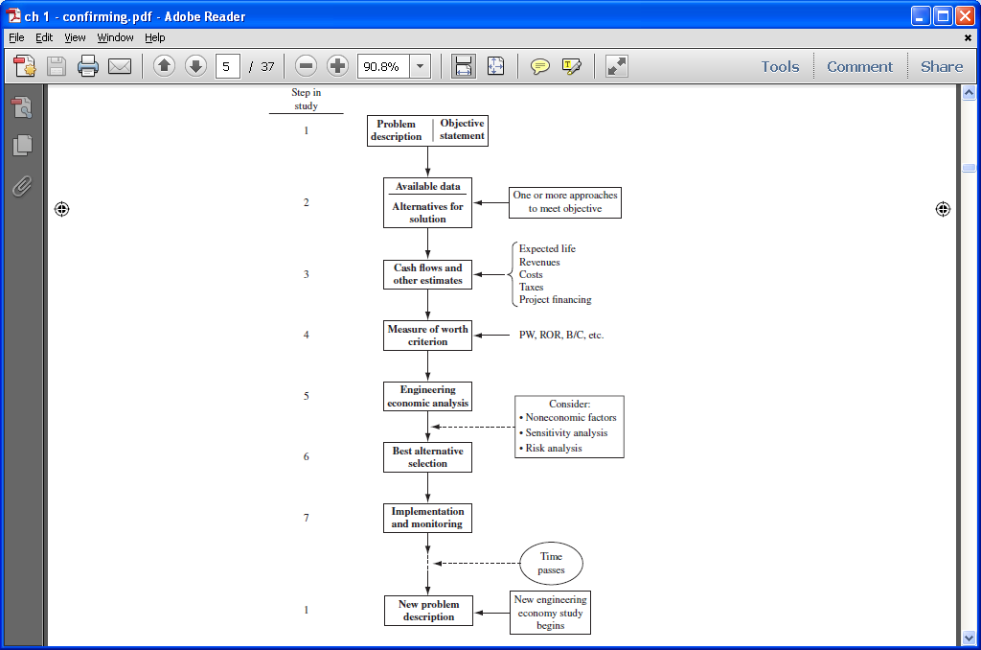
Steps in an Engineering Economy Study

Slide 8
Ethics – Different Levels
Universal morals or ethics – Fundamental beliefs: stealing, lying, harming or murdering another are wrong
Personal morals or ethics – Beliefs that an individual has and maintains over time; how a universal moral is interpreted and used by each person
Professional or engineering ethics – Formal standard or code that guides a person in work activities and decision making

Slide 9
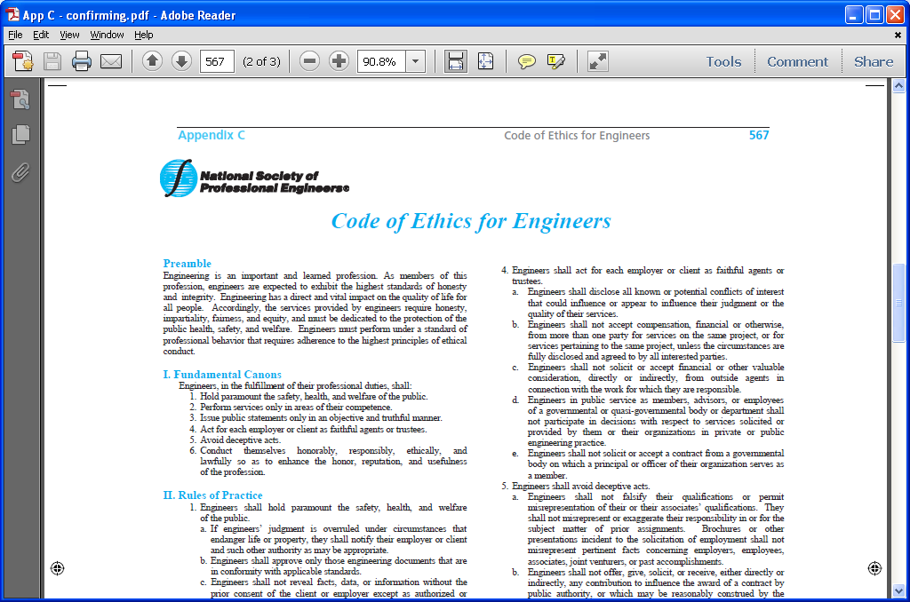
Code of Ethics for Engineers

Slide 10
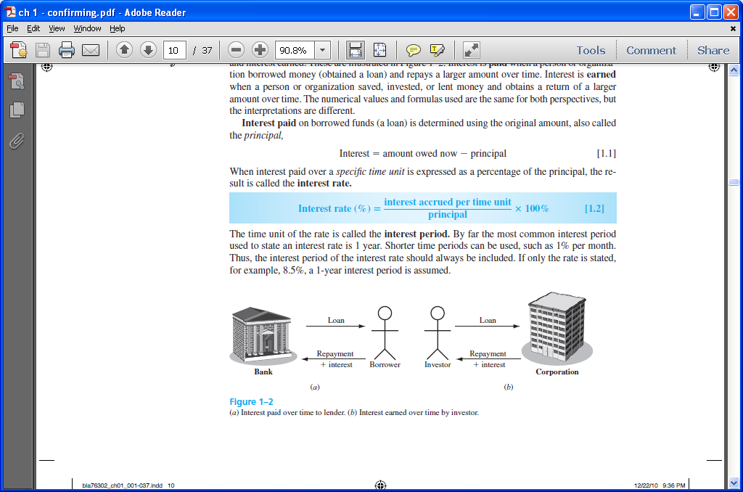
Interest and Interest Rate
Interest – the manifestation of the time value of money
  Fee that one pays to use someone else’s money
  Difference between an ending amount of money and a beginning amount of money
    Interest = amount owed now – principal
Interest rate – Interest paid over a time period expressed as a percentage of principal

Slide 11

Rate of Return
Interest earned over a period of time is expressed as a percentage of the original amount (principal)
Borrower’s perspective – interest rate paid
Lender’s or investor’s perspective – rate of return earned

Slide 12
Interest paid Interest earned
Interest rate
Rate of return

Slide 13
Commonly used Symbols
t = time, usually in periods such as years or months
P = value or amount of money at a time t designated as present or time 0
F = value or amount of money at some future time, such as at t = n periods in the future
A = series of consecutive, equal, end-of-period amounts of money
n = number of interest periods; years, months
i = interest rate or rate of return per time period; percent per year or month
© 2012 by McGraw-Hill, New York, N.Y All Rights Reserved
1-<number>

Slide 14
Cash Flows: Terms
Cash Inflows – Revenues (R), receipts, incomes, savings generated by projects and activities that flow in. Plus sign used
Cash Outflows – Disbursements (D), costs, expenses, taxes caused by projects and activities that flow out. Minus sign used
Net Cash Flow (NCF) for each time period:
  NCF = cash inflows – cash outflows = R – D
End-of-period assumption:
  Funds flow at the end of a given interest period

Slide 15
Cash Flows: Estimating
Point estimate – A single-value estimate of a cash flow element of an alternative
  Cash inflow: Income = $150,000 per month
Range estimate – Min and max values that estimate the cash flow
Cash outflow: Cost is between $2.5 M and $3.2 M
Point estimates are commonly used; however, range estimates with probabilities attached provide a better understanding of variability of economic parameters used to make decisions
© 2012 by McGraw-Hill, New York, N.Y All Rights Reserved
1-<number>

Slide 16
Cash Flow Diagrams
What a typical cash flow diagram might look like
Draw a time line
Always assume end-of-period cash flows
Time
0 1 2 … … … n - 1 n
One time period
F = $100
Show the cash flows (to approximate scale)
0 1 2 … … … n-1 n
Cash flows are shown as directed arrows: + (up) for inflow
- (down) for outflow
P = $-80
1-<number>
© 2012 by McGraw-Hill, New York, N.Y All Rights Reserved

Slide 17
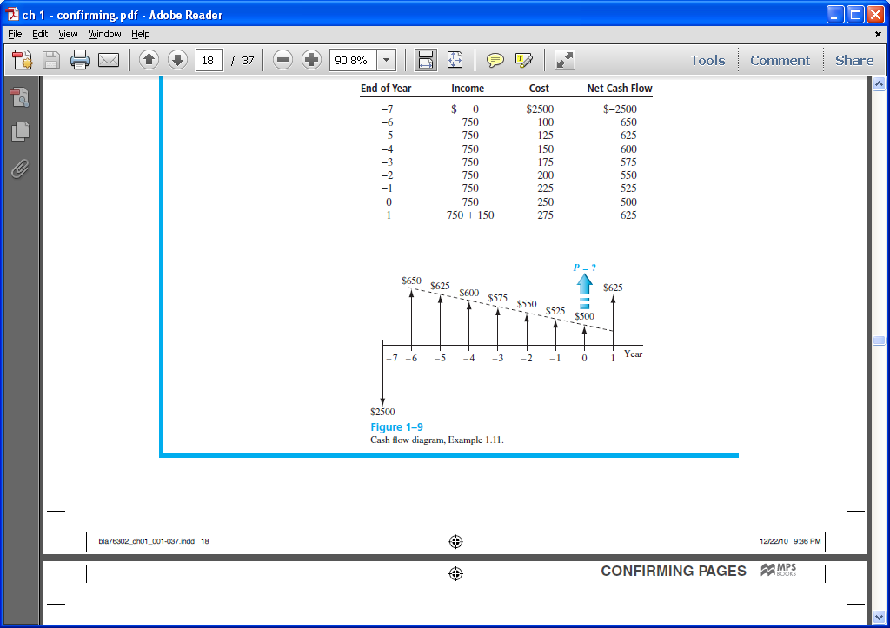
Cash Flow Diagram Example
Plot observed cash flows over last 8 years and estimated sale next year for $150. Show present worth (P) arrow at present time, t = 0
1-<number>
© 2012 by McGraw-Hill, New York, N.Y All Rights Reserved

Slide 18
Economic Equivalence
Definition: Combination of interest rate (rate of return) and time value of money to determine different amounts of money at different points in time that are economically equivalent
How it works: Use rate i and time t in upcoming relations to move money (values of P, F and A) between time points t = 0, 1, …, n to make them equivalent (not equal) at the rate i
© 2012 by McGraw-Hill, New York, N.Y All Rights Reserved
1-<number>

Slide 19
Example of Equivalence
Different sums of money at different times may be equal in economic value at a given rate
$110
Year
0 1
Rate of return = 10% per year
$100 now
$100 now is economically equivalent to $110 one year from now, if the $100 is invested at a rate of 10% per year.
© 2012 by McGraw-Hill, New York, N.Y All Rights Reserved
1-<number>

Slide 20
Simple and Compound Interest
Simple Interest
  Interest is calculated using principal only
  Interest = (principal)(number of periods)(interest rate)
  I = Pni
Example: $100,000 lent for 3 years at simple i = 10% per year. What is repayment after 3 years?
Interest = 100,000(3)(0.10) = $30,000
Total due = 100,000 + 30,000 = $130,000
© 2012 by McGraw-Hill, New York, N.Y All Rights Reserved
1-<number>

Slide 21
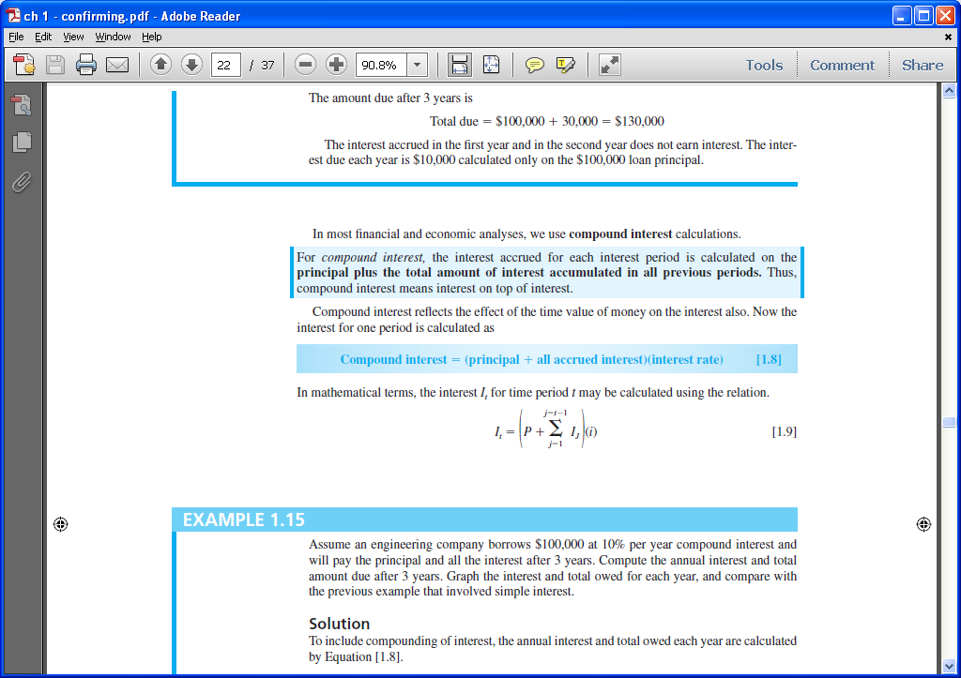
Simple and Compound Interest
Compound Interest
  Interest is based on principal plus all accrued interest
  That is, interest compounds over time
  Interest = (principal + all accrued interest) (interest rate)
Interest for time period t is
© 2012 by McGraw-Hill, New York, N.Y All Rights Reserved
1-<number>

Slide 22
Compound Interest Example
Example: $100,000 lent for 3 years at i = 10% per year compounded. What is repayment after 3 years?
Interest, year 1: I₁ = 100,000(0.10) = $10,000
Total due, year 1: T₁ = 100,000 + 10,000 = $110,000
Interest, year 2: I₂ = 110,000(0.10) = $11,000
Total due, year 2: T₂ = 110,000 + 11,000 = $121,000
Interest, year 3: I₃ = 121,000(0.10) = $12,100
Total due, year 3: T₃ = 121,000 + 12,100 = $133,100
Compounded: $133,100 Simple: $130,000
1-<number>
© 2012 by McGraw-Hill, New York, N.Y All Rights Reserved

Slide 23
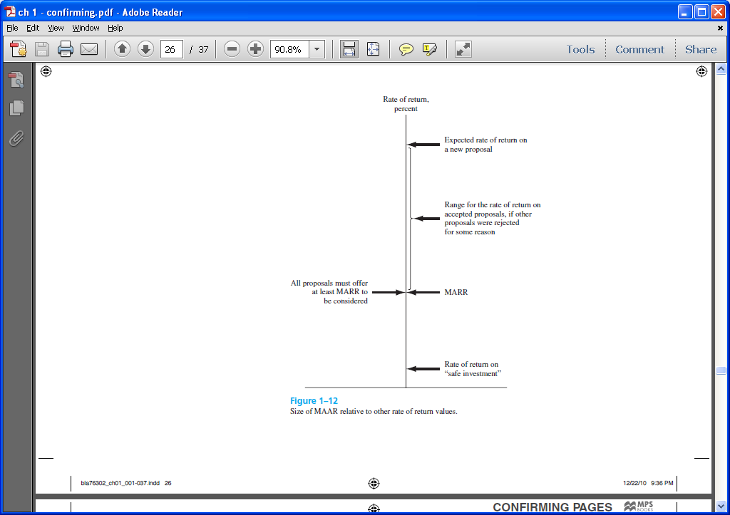
Minimum Attractive Rate of Return
MARR is a reasonable rate of return (percent) established for evaluating and selecting alternatives
An investment is justified economically if it is expected to return at least the MARR
Also termed hurdle rate, benchmark rate and cutoff rate
1-<number>
© 2012 by McGraw-Hill, New York, N.Y All Rights Reserved

Slide 24
MARR Characteristics
MARR is established by the financial managers of the firm
MARR is fundamentally connected to the cost of capital
Both types of capital financing are used to determine the weighted average cost of capital (WACC) and the MARR
MARR usually considers the risk inherent to a project
1-<number>
© 2012 by McGraw-Hill, New York, N.Y All Rights Reserved

Slide 25
Types of Financing
Equity Financing –Funds either from retained earnings, new stock issues, or owner’s infusion of money.
Debt Financing –Borrowed funds from outside sources – loans, bonds, mortgages, venture capital pools, etc. Interest is paid to the lender on these funds
For an economically justified project
ROR ≥ MARR > WACC
1-<number>
© 2012 by McGraw-Hill, New York, N.Y All Rights Reserved

Slide 26
Opportunity Cost
Definition: Largest rate of return of all projects not accepted (forgone) due to a lack of capital funds
If no MARR is set, the ROR of the first project not undertaken establishes the opportunity cost
Example: Assume MARR = 10%. Project A, not funded due to lack of funds, is projected to have ROR_{A} = 13%. Project B has ROR_{B} = 15% and is funded because it costs less than A
Opportunity cost is 13%, i.e., the opportunity to make an additional 13% is forgone by not funding project A
1-<number>
© 2012 by McGraw-Hill, New York, N.Y All Rights Reserved

Slide 27
Introduction to Spreadsheet Functions
Excel financial functions
  Present Value, P: = PV(i%,n,A,F)
  Future Value, F: = FV(i%,n,A,P)
  Equal, periodic value, A: = PMT(i%,n,P,F)
  Number of periods, n: = NPER((i%,A,P,F)
  Compound interest rate, i: = RATE(n,A,P,F)
  Compound interest rate, i: = IRR(first_cell:last_cell)
  Present value, any series, P: = NPV(i%,second_cell:last_cell) + first_cell
  Example: Estimates are P = $5000 n = 5 years i = 5% per year
  Find A in $ per year
  Function and display: = PMT(5%, 5, 5000) displays A = $1154.87
1-<number>
© 2012 by McGraw-Hill, New York, N.Y All Rights Reserved

